Slide 1
House Hold Smart Share
Project Supervisor:
Md. Nesarul Hoque
Assistant Professor
Department of CSE,BSMRSTU
Gopalganj-8100.
Submitted By:
Md. Imran Hosen
Student ID: 18CSE019
Department of CSE,BSMRSTU
Gopalganj-8100.

Slide 2
Outline
Introduction
Motivation
About the Application
Features and Result
Implementation
Future scope of the program
Conclusions

Slide 3
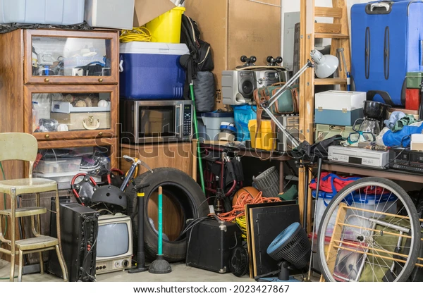
Introduction
Our old things do not turn into dirt and are useful for someone else to use. So that people benefit.

Slide 4
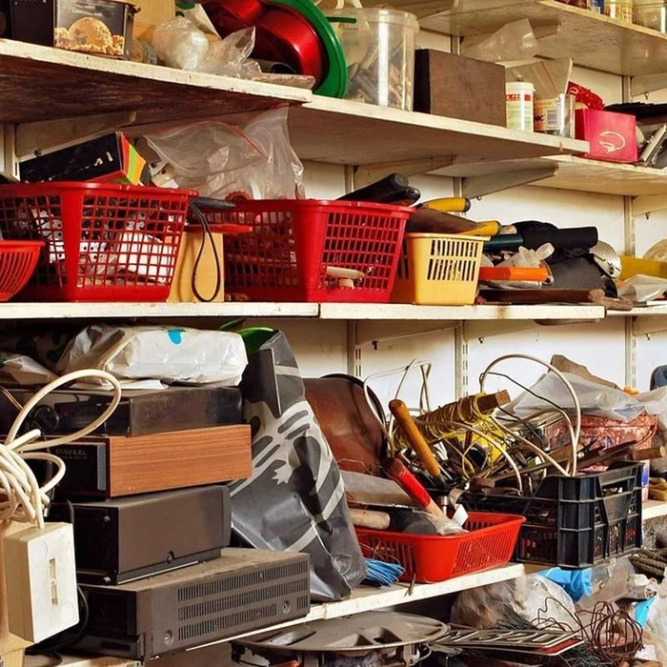
Motivation
We have so many things around us that we don't use them. I am motivated to see, how these item can be used.

Slide 5
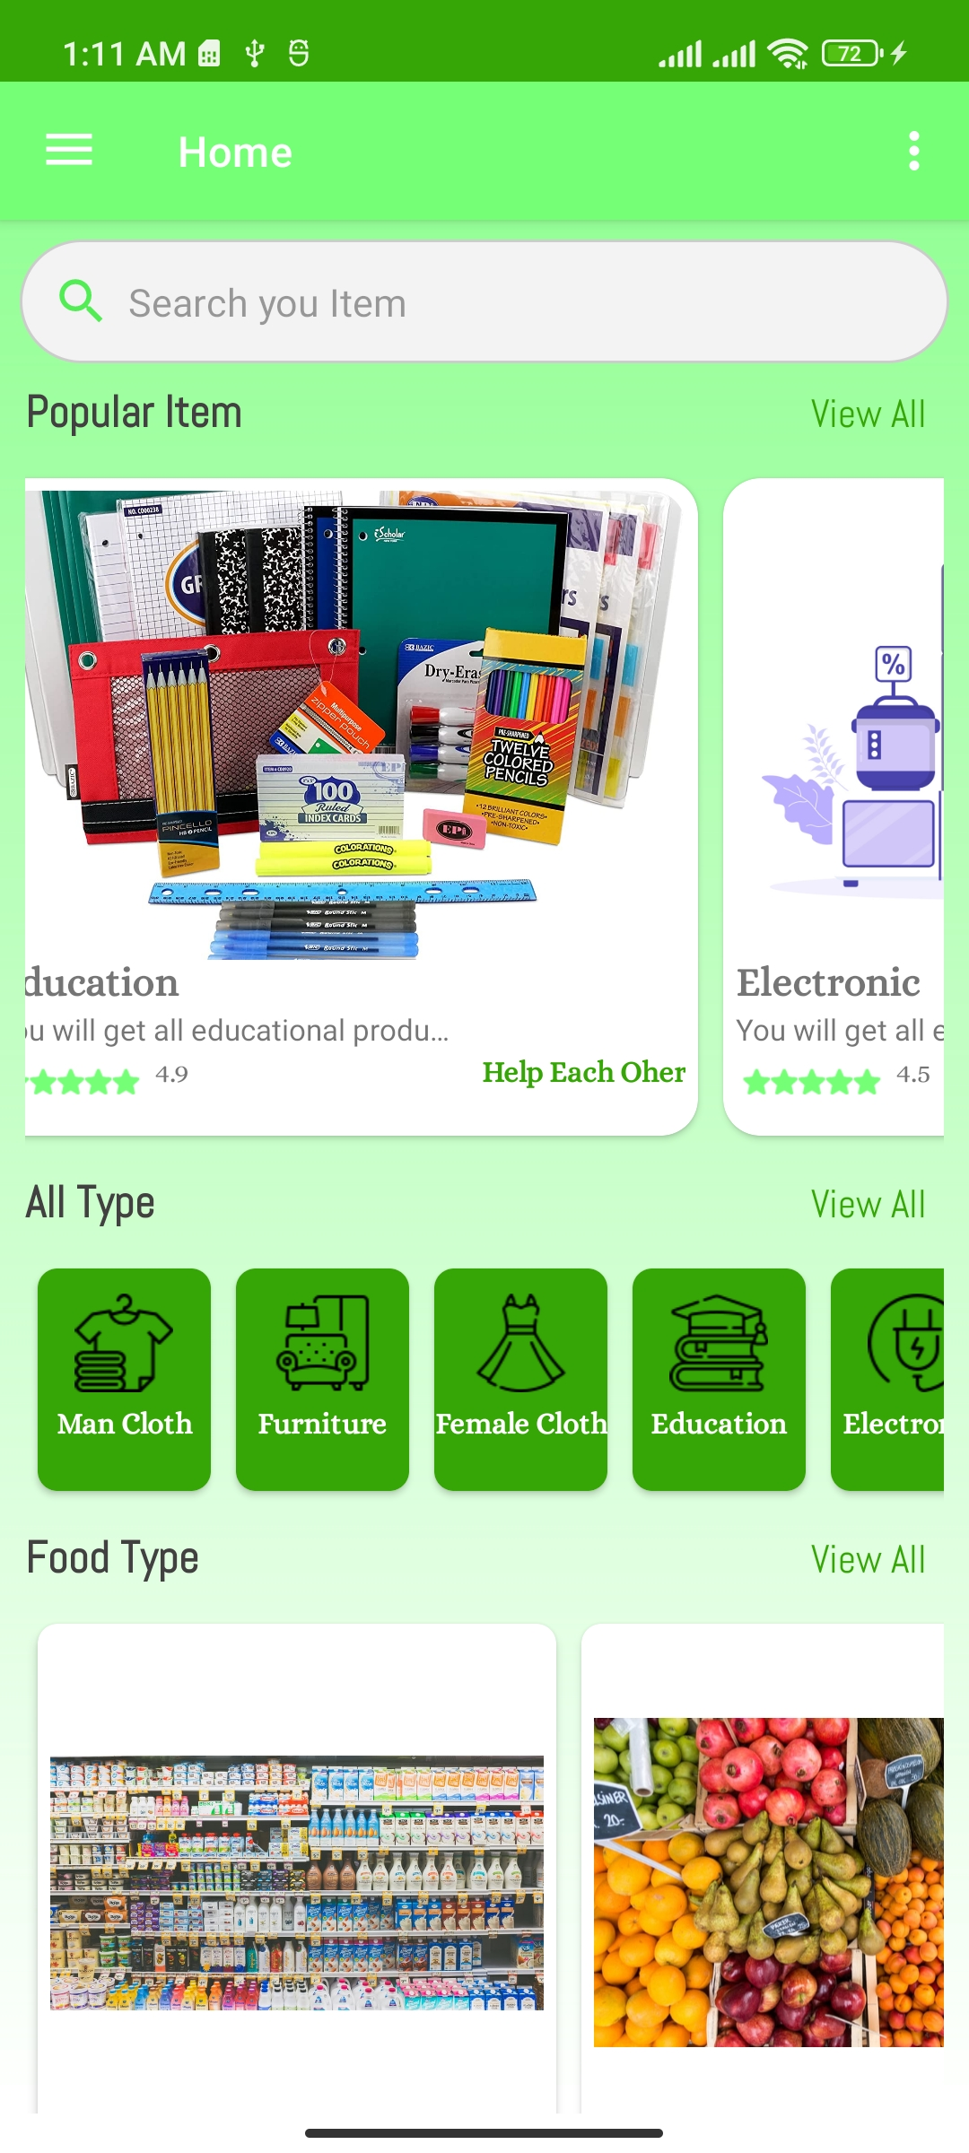
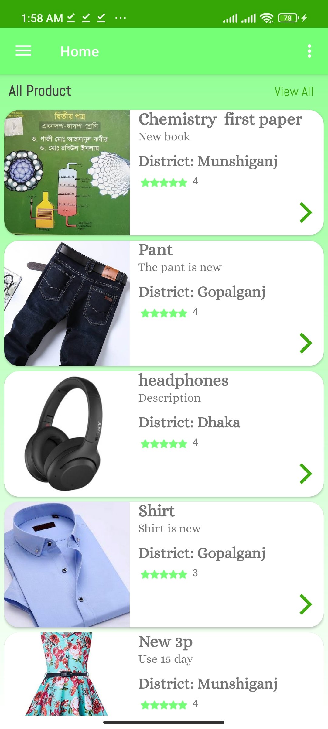
About The application
We made this application where people can upload unused items in this application. Those who need these items can request through this application.

Slide 6
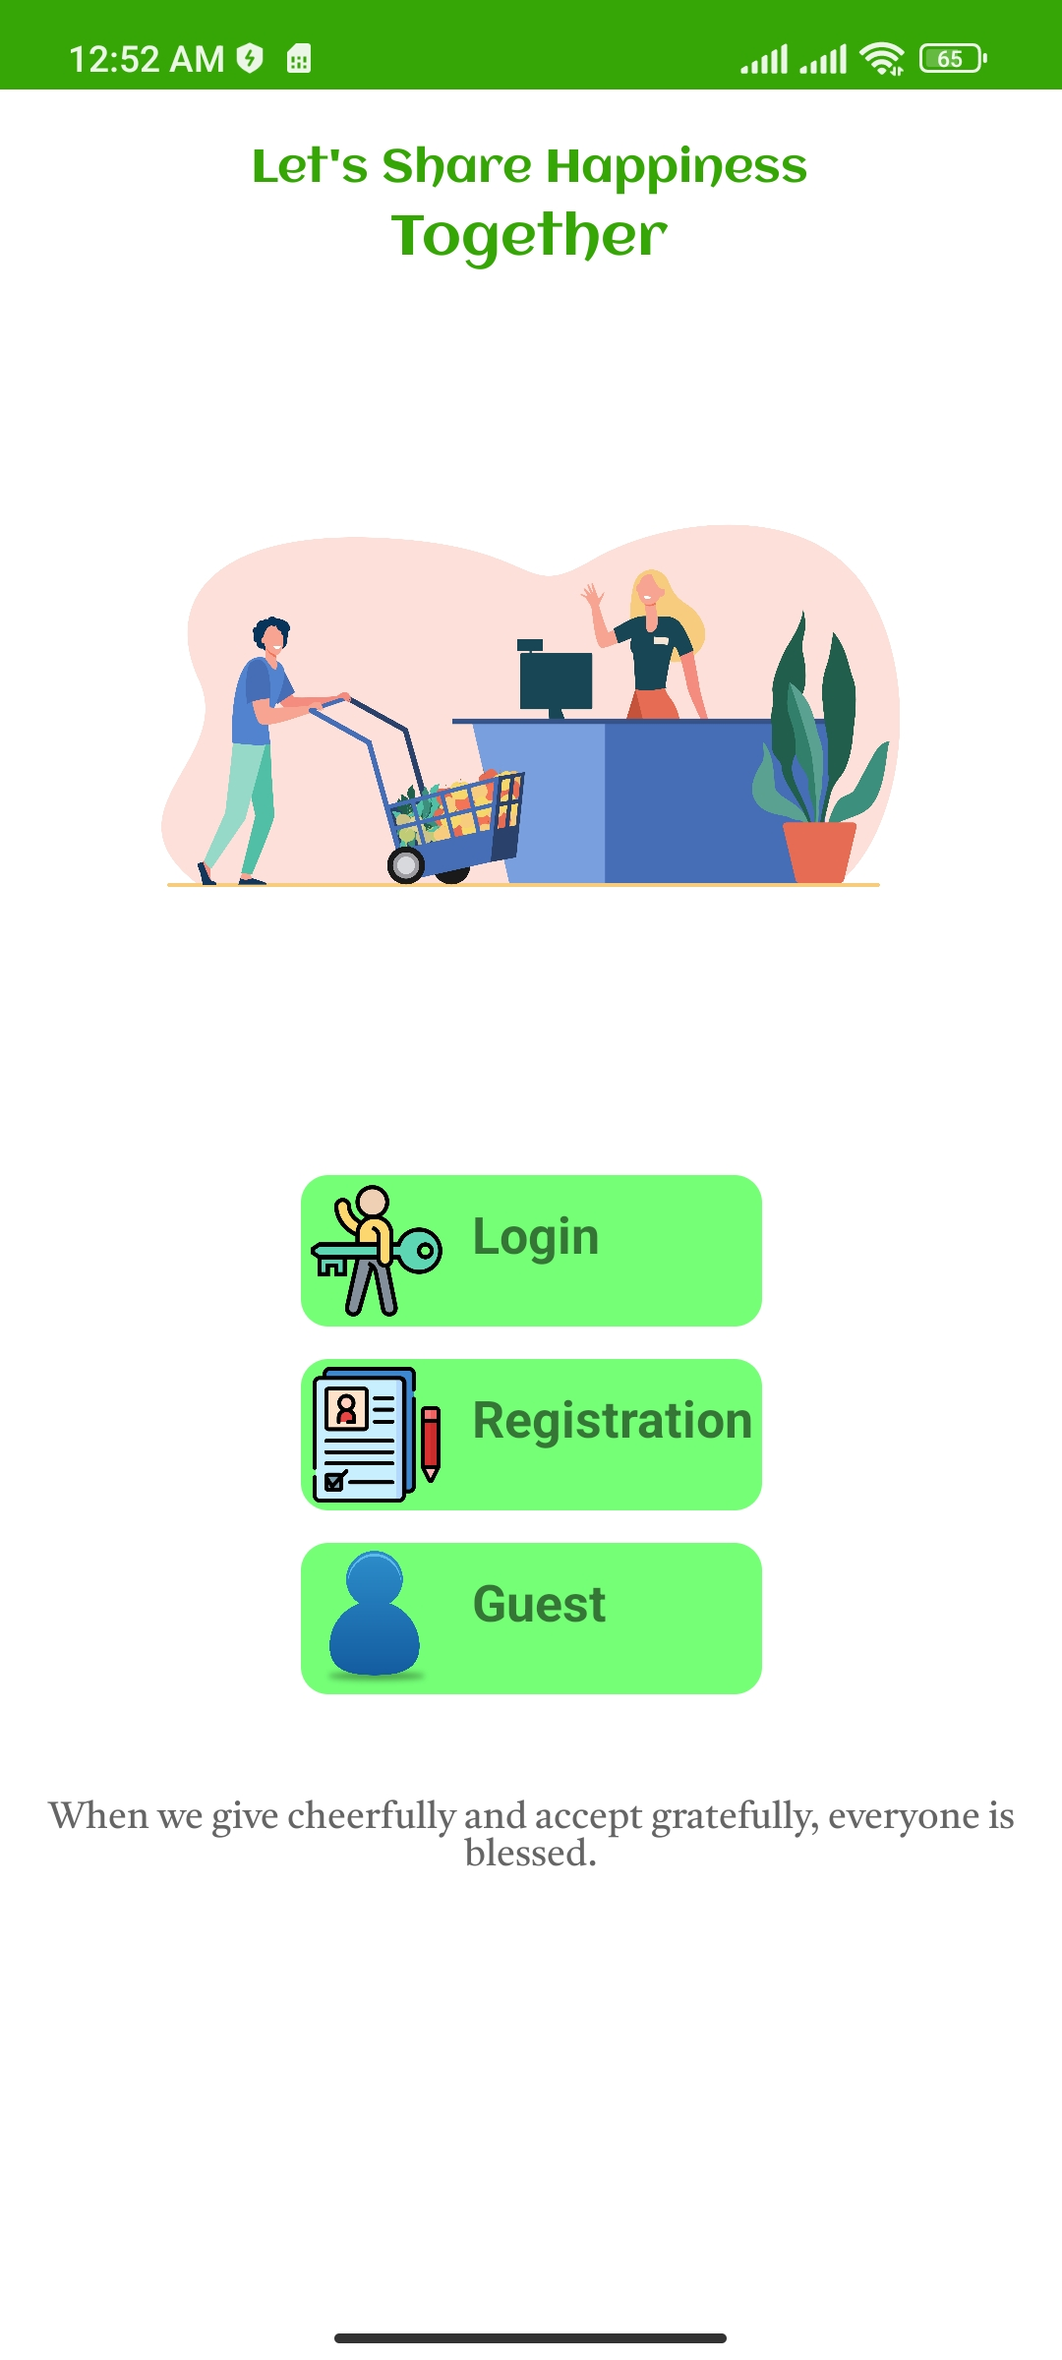
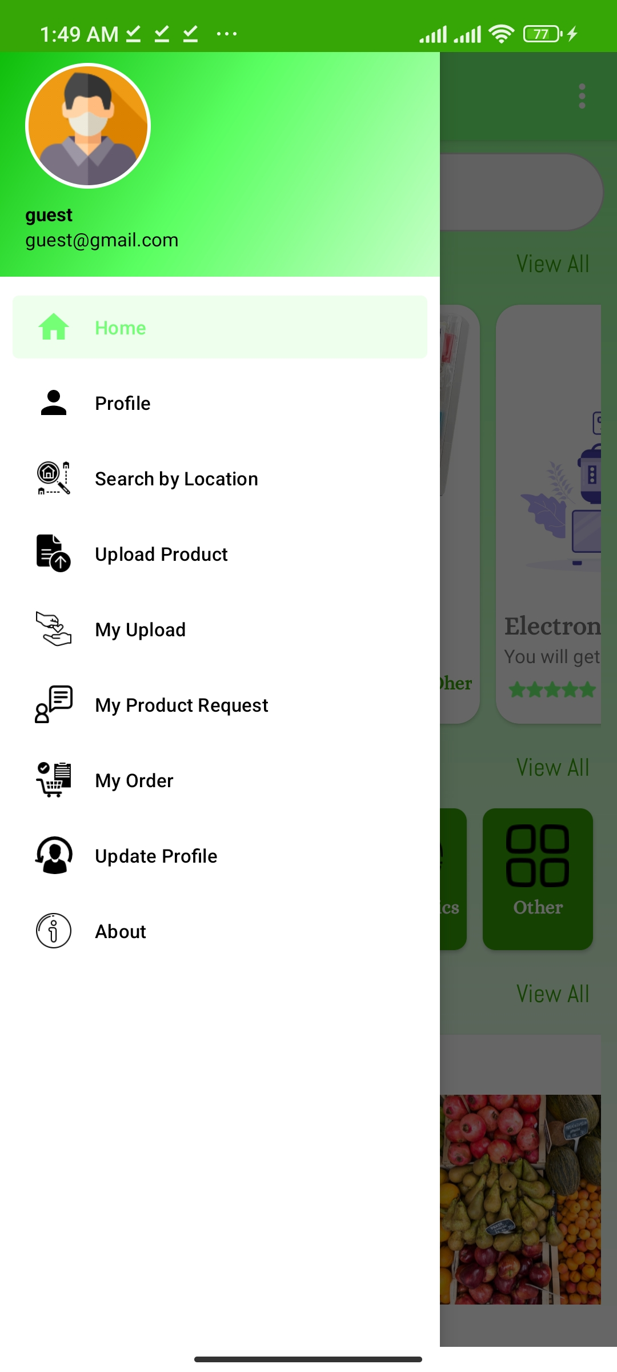
Features of Application
Login, Registration and
Guest Mode
Upload item
Divide item in category
Search Item by type
Search item by location
Request and delete item
Profile and Update profile

Slide 7
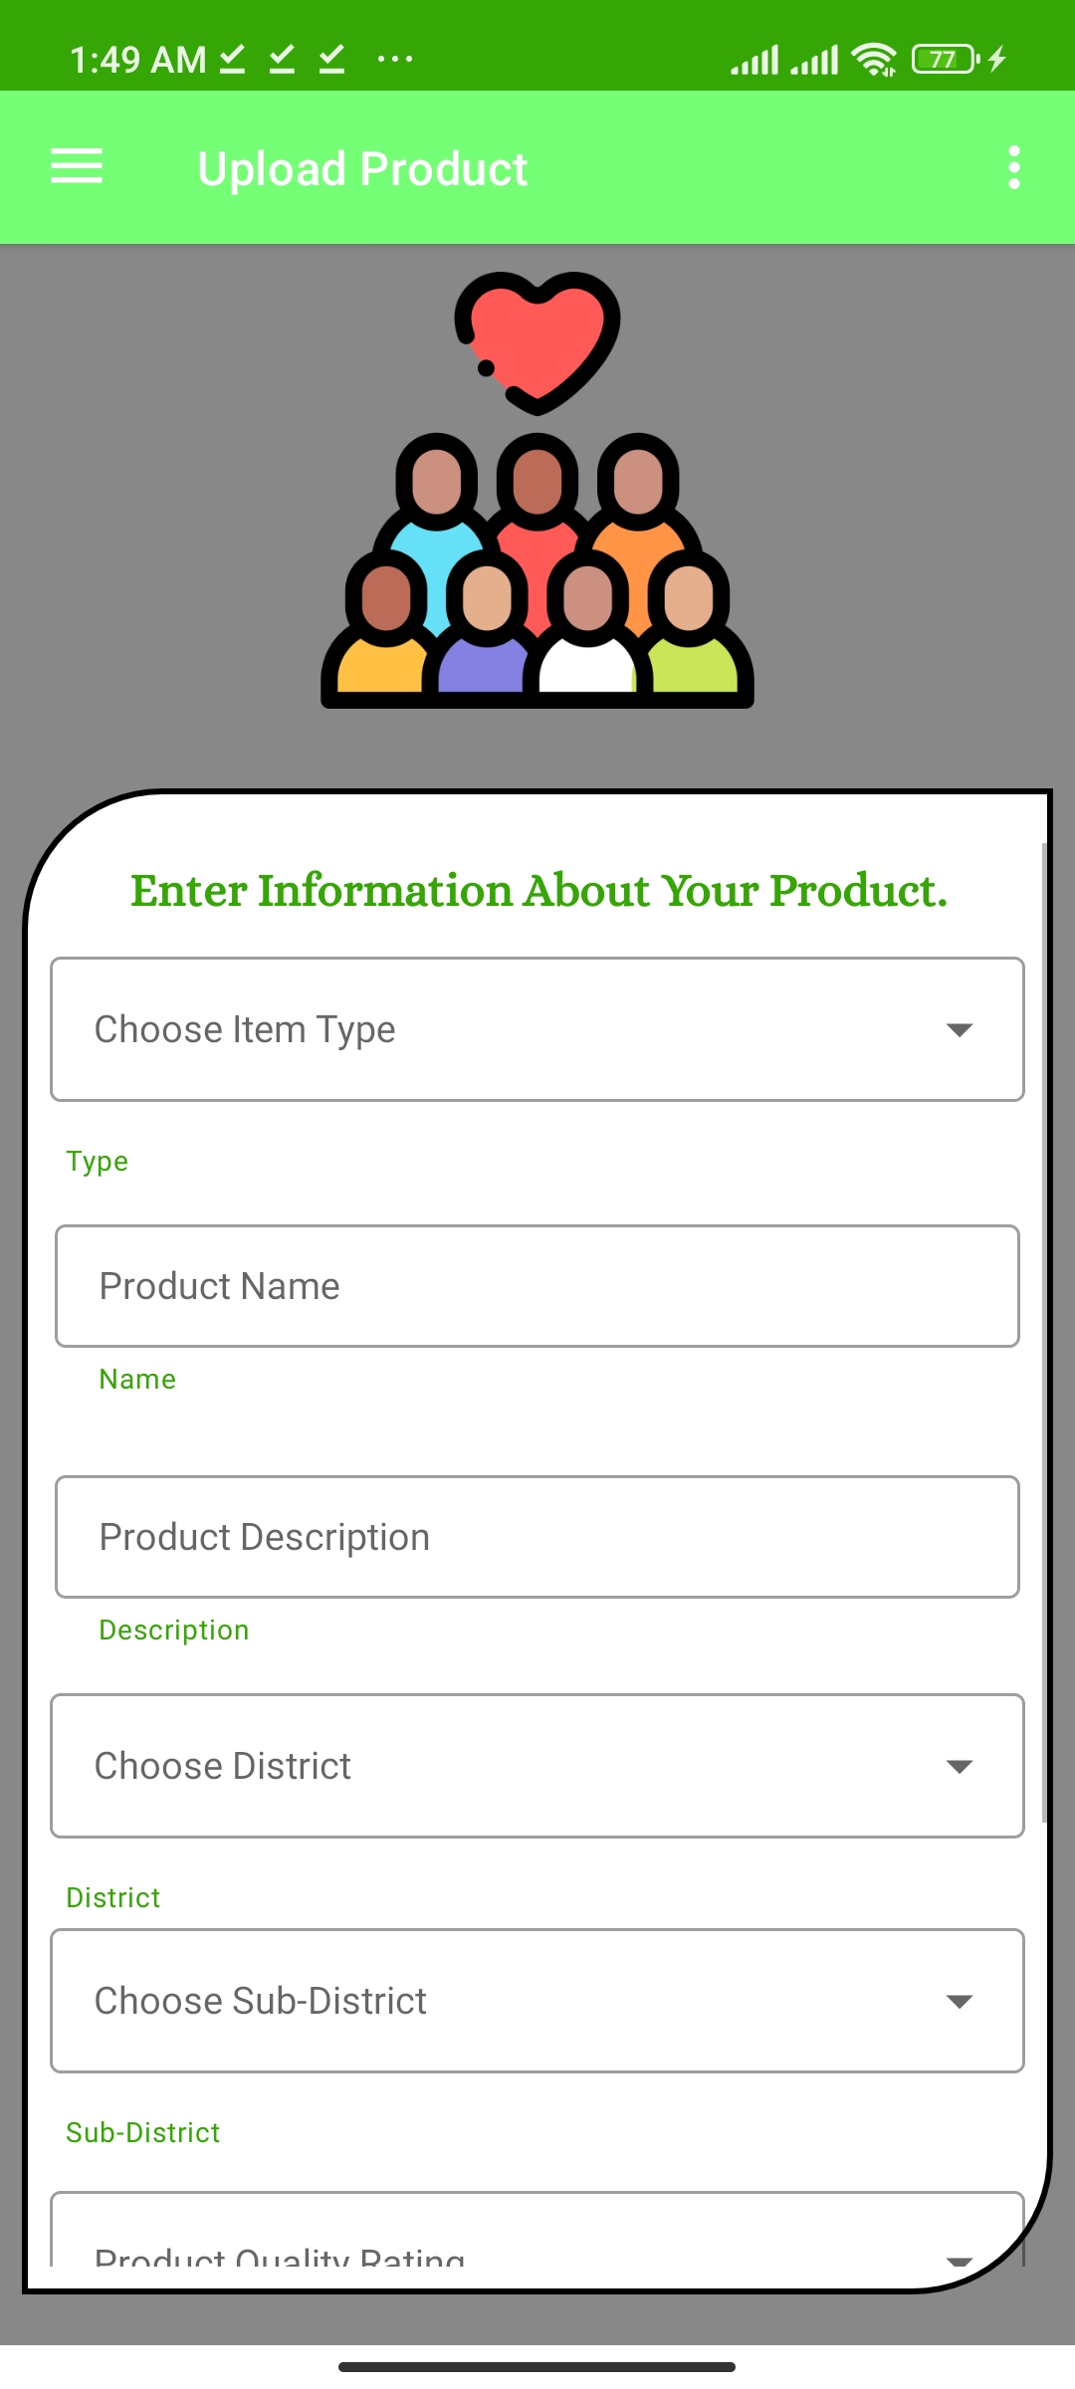
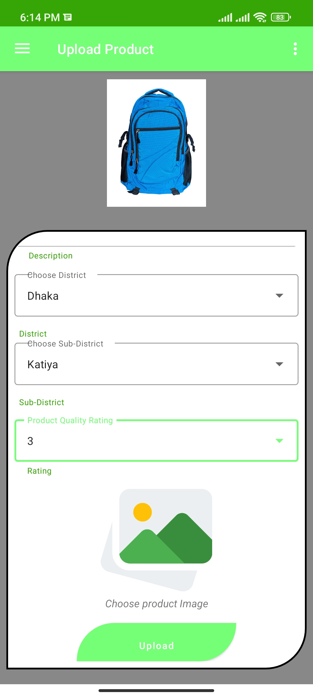
Upload item
Upload item by region
Item picture upload
Rating feature

Slide 8
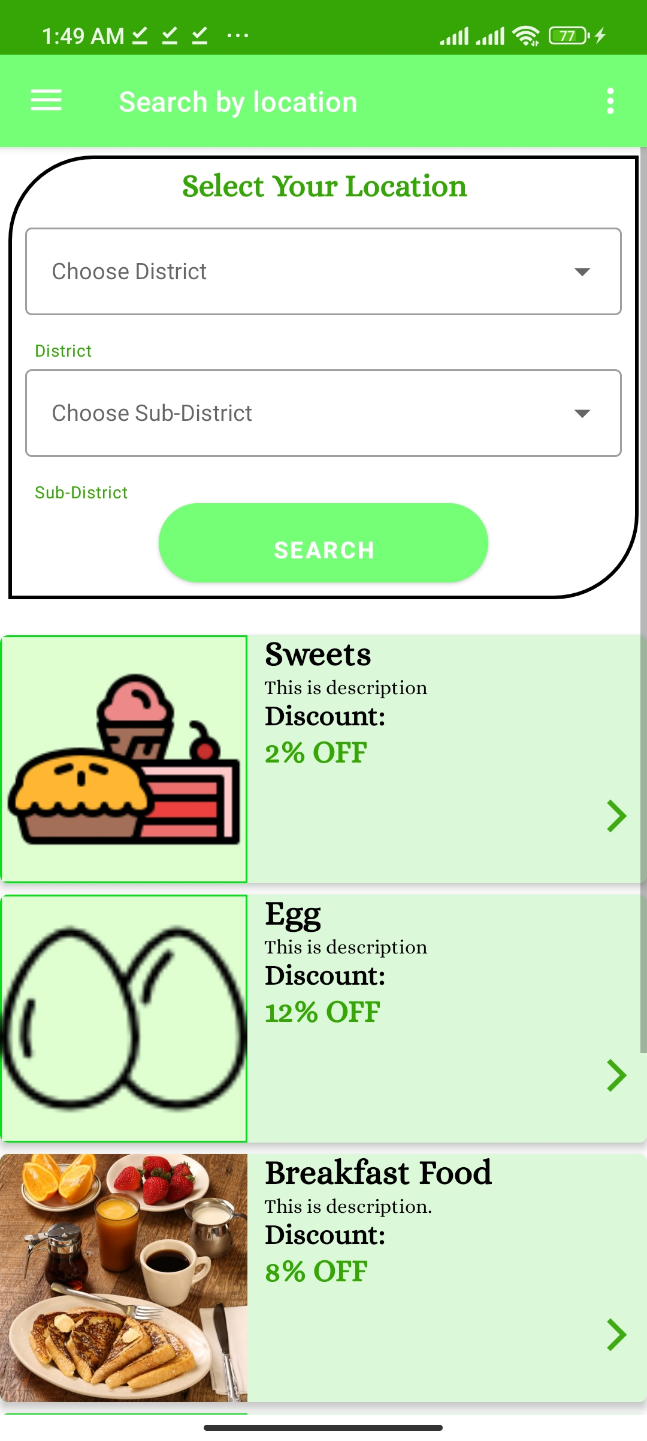
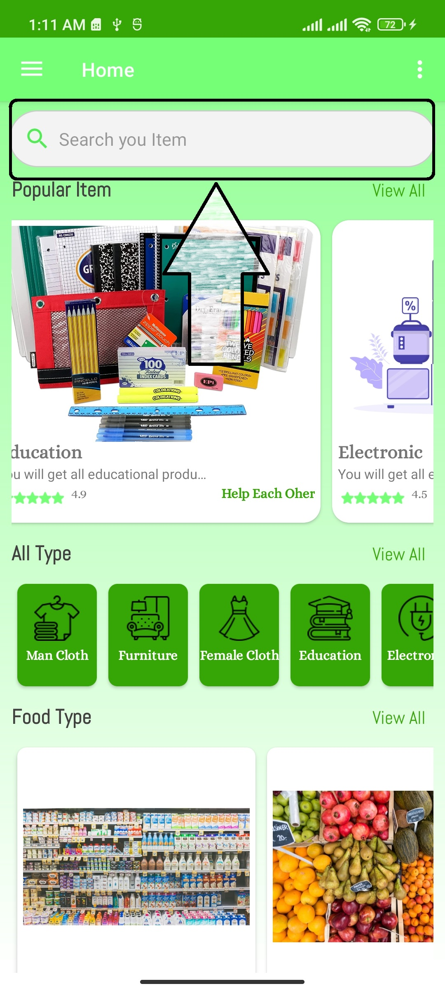
Search Item
Save time
Find your nearby item

Slide 9
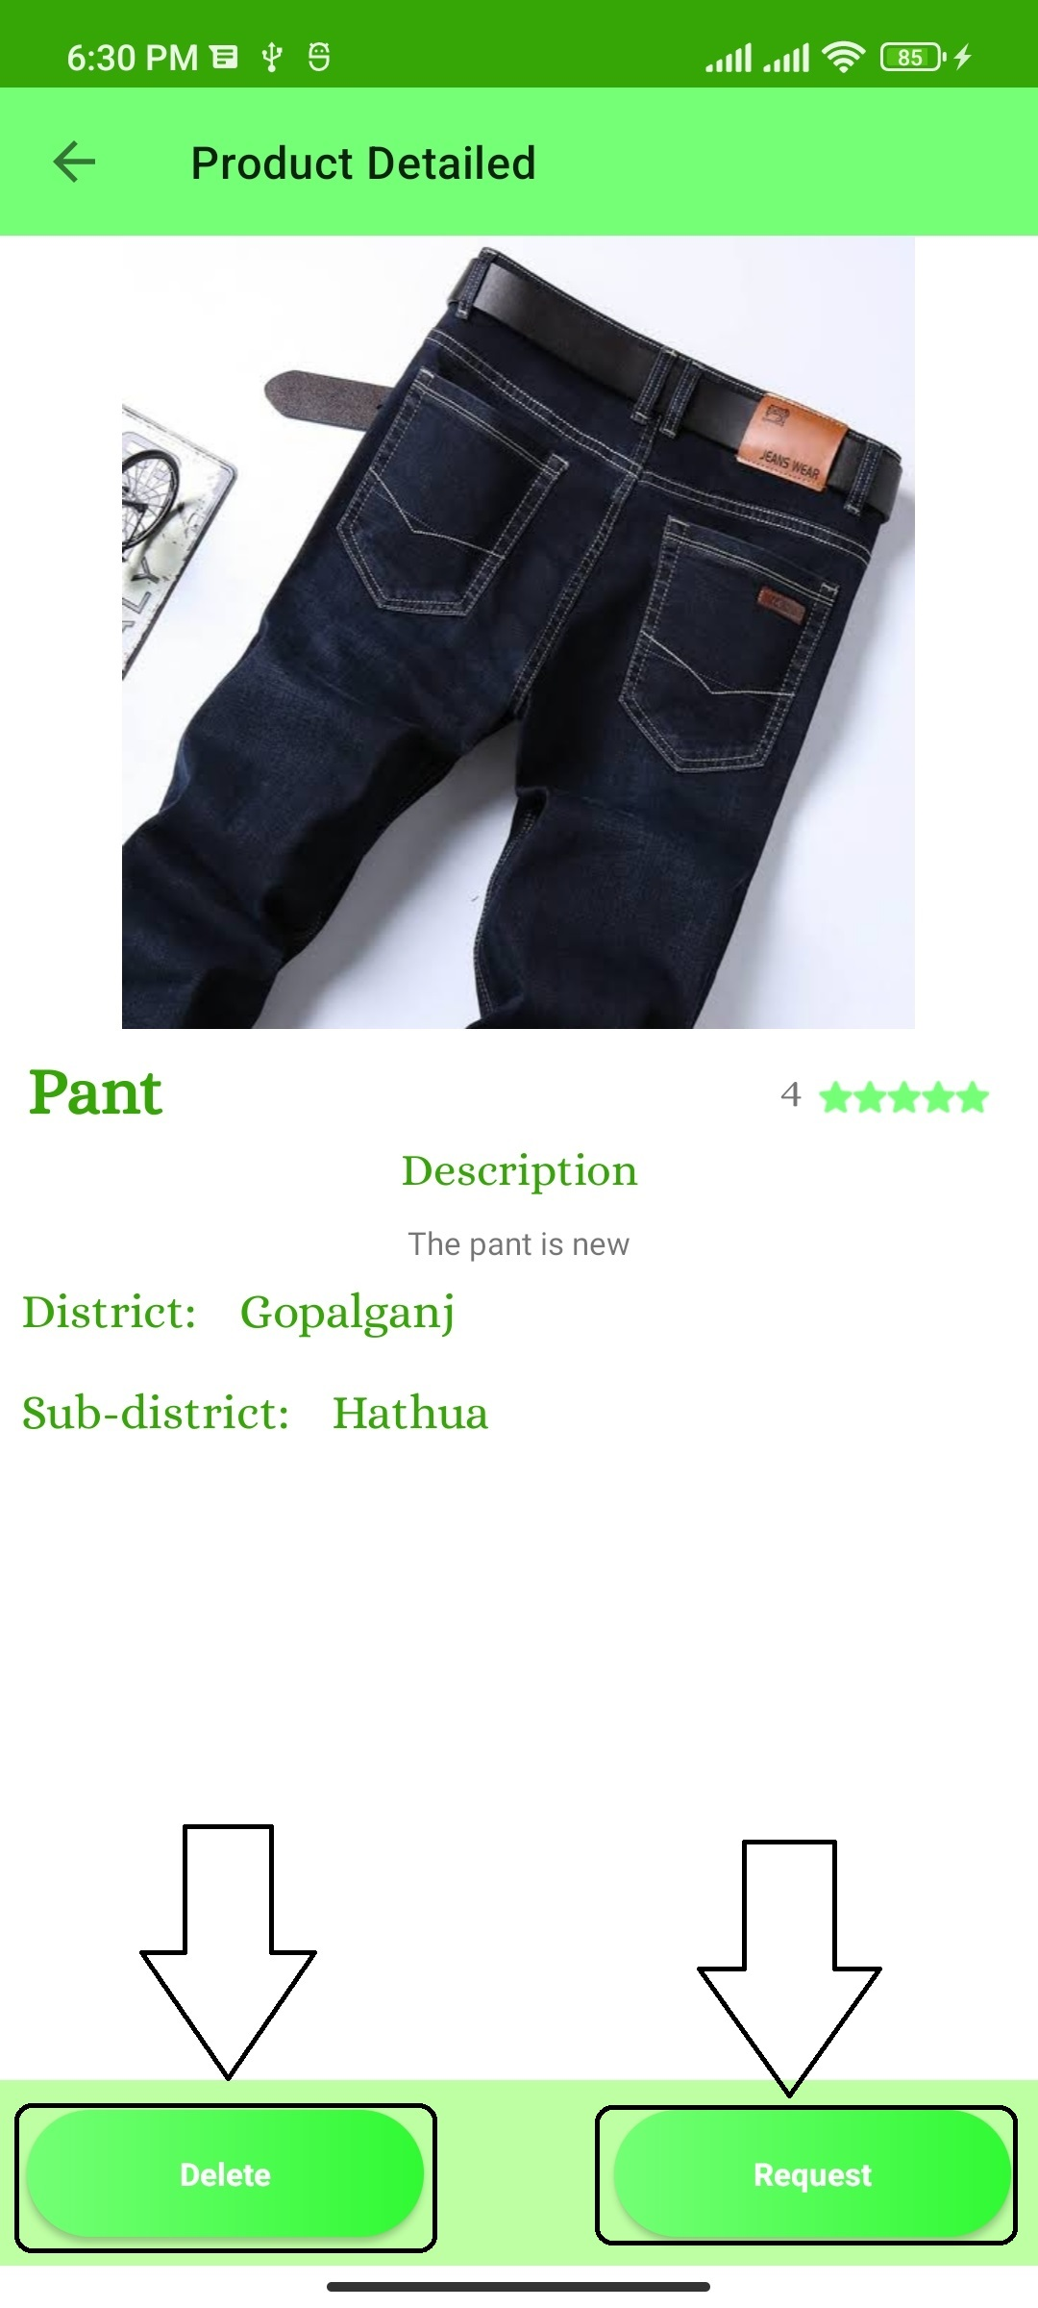
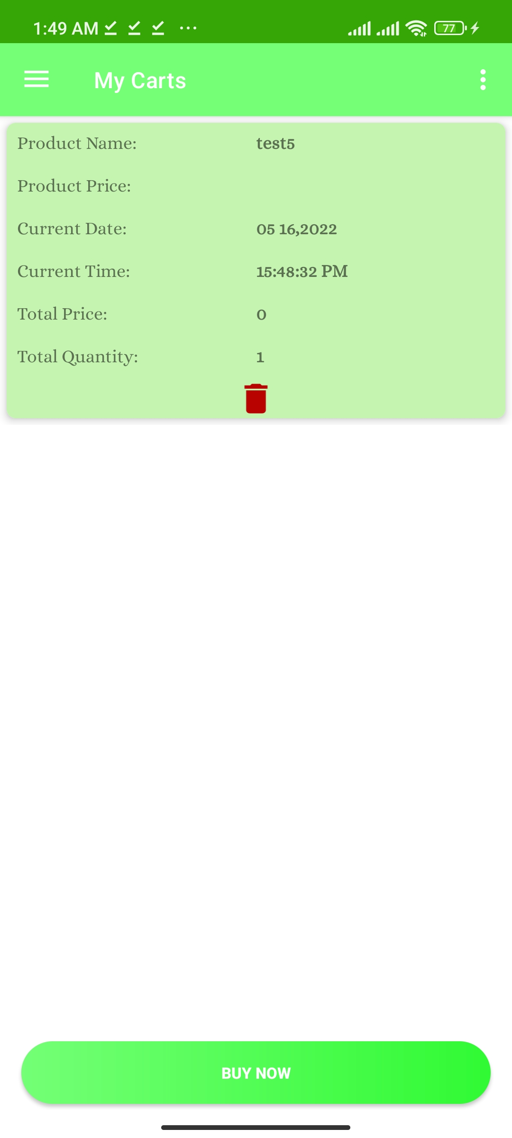
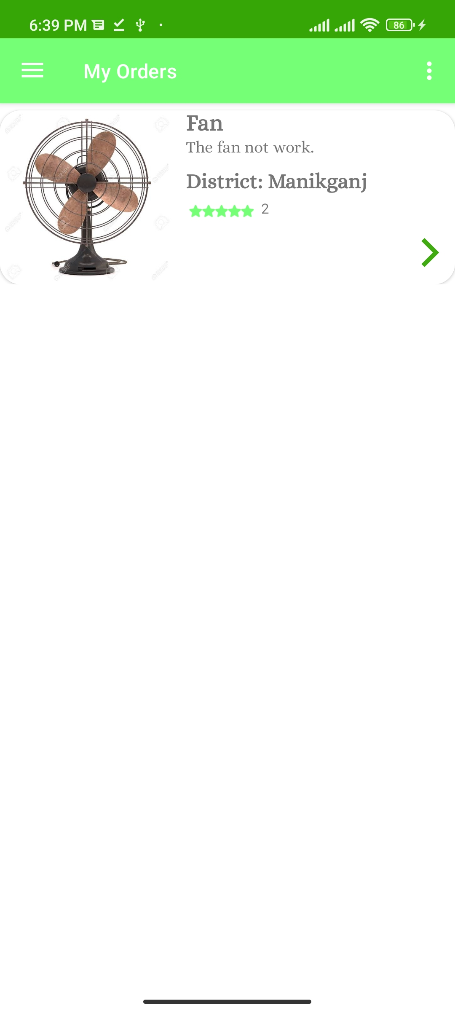
Request and delete item
Save time
Find your nearby item

Slide 10
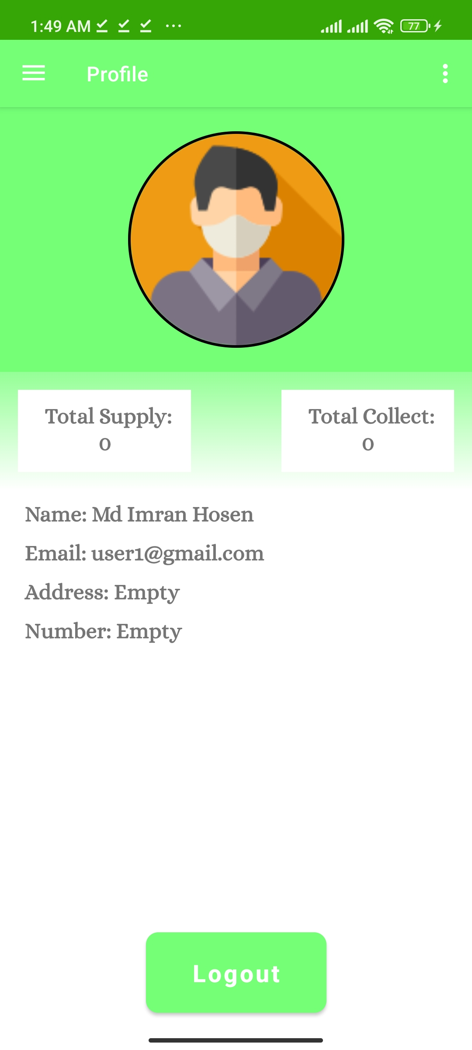
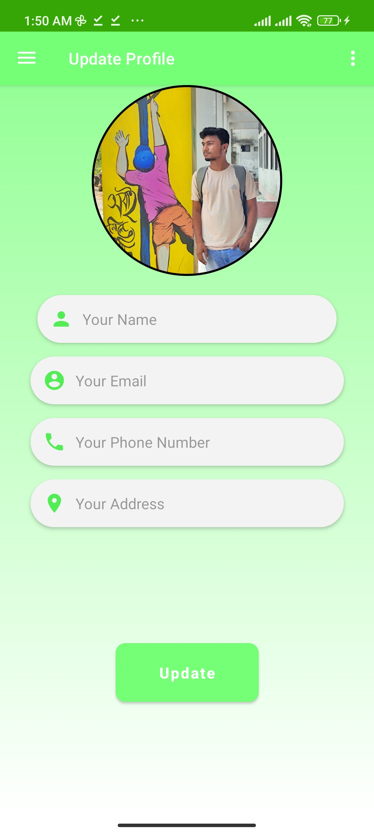
Profile and Update Profile
Total Supply and Collect
Update Image and other details

Slide 11

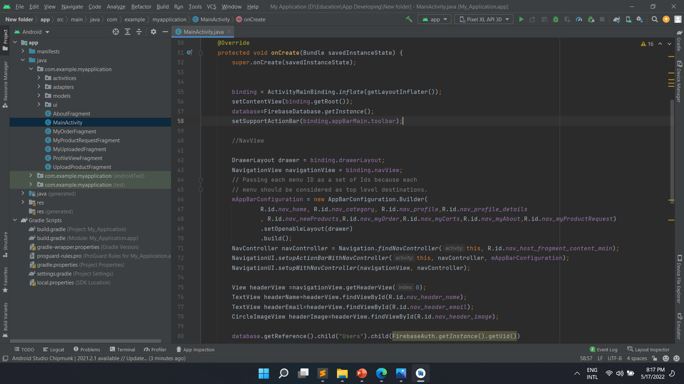


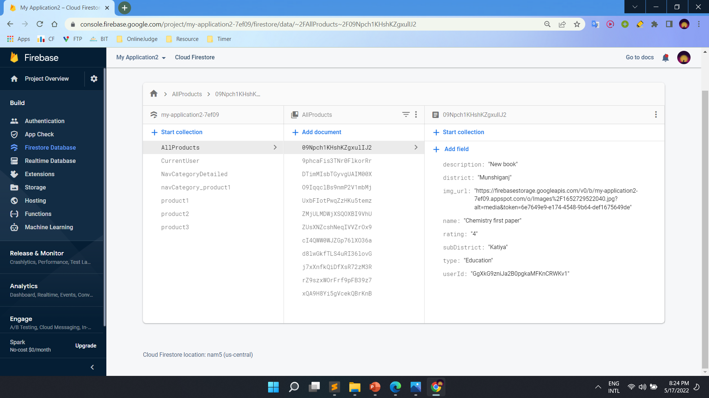
IMPLEMENTATION
Android Studio
Java language
XML language
Firebase Database

Slide 12
Future scope of the program
Add google map for searching
Add chat system
More friendly Interface
More security

Slide 13
Conclusions
This android application will help people to used an unused item.

Slide 14
THANKS!

